Slide 1

Why XaaS is becoming a dominant consumption model in modern IT.
Presented by Dhiliban M (192421166)
Buvanesh Y(192372367)
Madhan R(192324256)
CSA1522-CLOUD COMPUTING AND BIG DATA ANALYTICS
CO1-AT2-Technical Presentation

Slide 2
OBJECTIVE
From Capital Costs to Strategic Agility
Replace CapEx with OpEx
Align with Growth
Reduce Time to Value
Move away from large, upfront hardware purchases toward pay‑as‑you‑consume operational models.
Dynamically scale resources to match demand spikes and business initiatives.
Provision services in minutes instead of weeks — speeding feature delivery and experiments.

Slide 3

Core Technical Concept:
XaaS decouples capabilities from physical hardware. Instead of fixed silos, capabilities (compute, storage, networking, security, databases, ML, etc.) are exposed as composable services via cloud‑native APIs.
From IaaS/PaaS to a unified service catalogue
API-driven orchestration and governance
Immutable, versioned service contracts for reliability

Slide 4
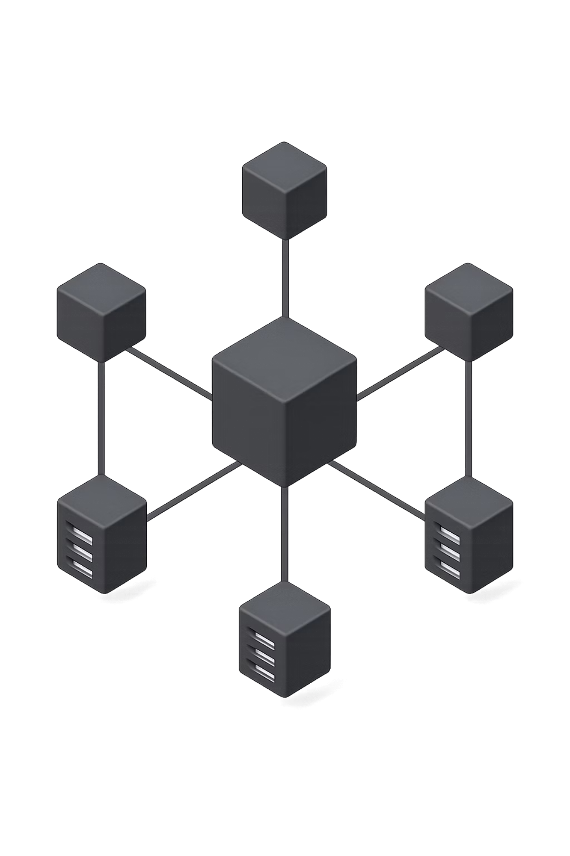
Architecture:
Modern Services Fabric
Modern deployments form a Services Fabric: a distributed control plane that composes logical resources (compute, network, storage) into policy‑driven services. This fabric supports multi‑cloud, edge and hybrid topologies with unified observability and enforcement.

Slide 5
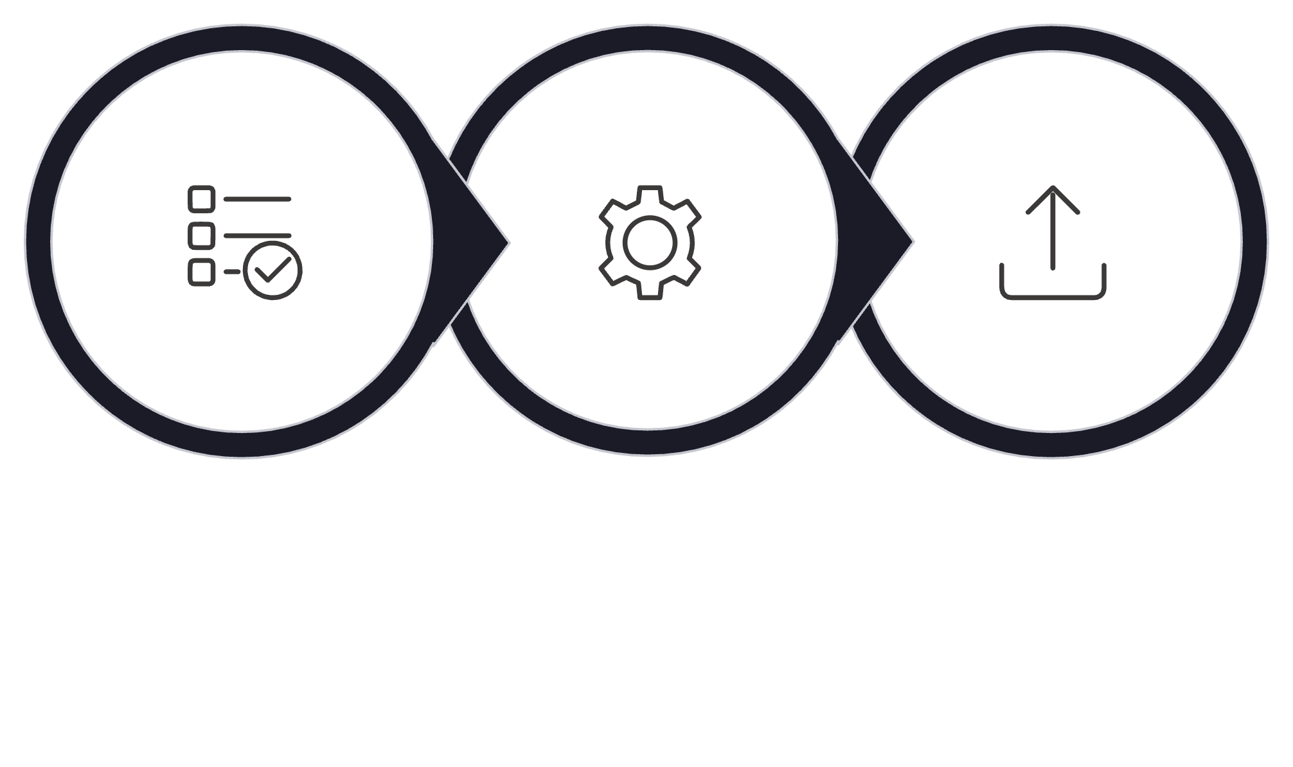
Architecture Process Diagram
Input
Mediation
Output
At runtime the fabric maps SLAs to resource templates, runs placement algorithms, and executes provisioning through standard APIs — closing the loop with telemetry and autoscaling.

Slide 6
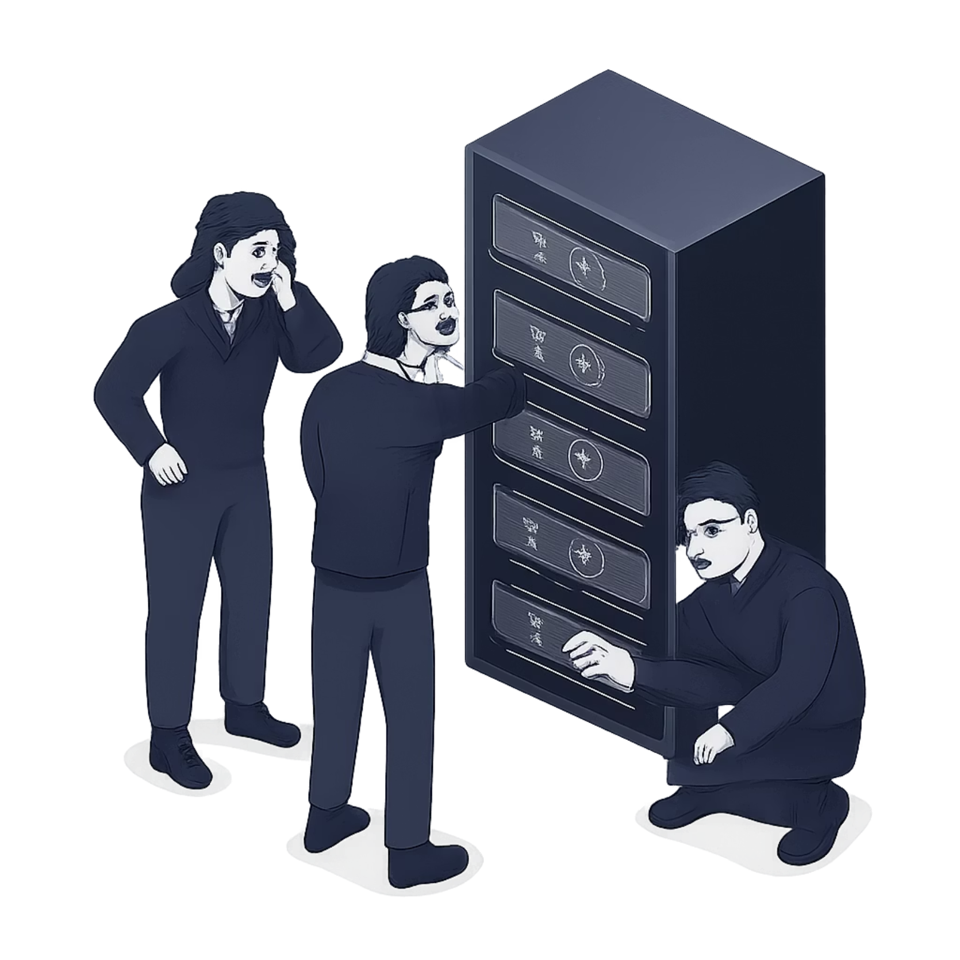
Business Drivers:
Legacy IT costs consume 2–5% of revenue and limit agility
Data volumes and demand variability make static capacity inefficient
FinOps and TCO pressures force precise, observable spending
Business expects fast innovation cycles and global reach

Slide 7
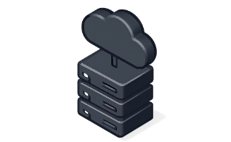

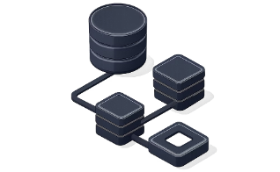
Real‑World Use Case: Scaling Innovation
Problem
Approach
Outcome
Prem storage caused long provisioning lead times and manual performance tuning.
Implement hybrid cloud storage as a service with automated tiering, API provisioning and FinOps tagging.
Resources provisioned in minutes, predictable costs, reduced manual caching and consistent SLAs across regions.

Slide 8
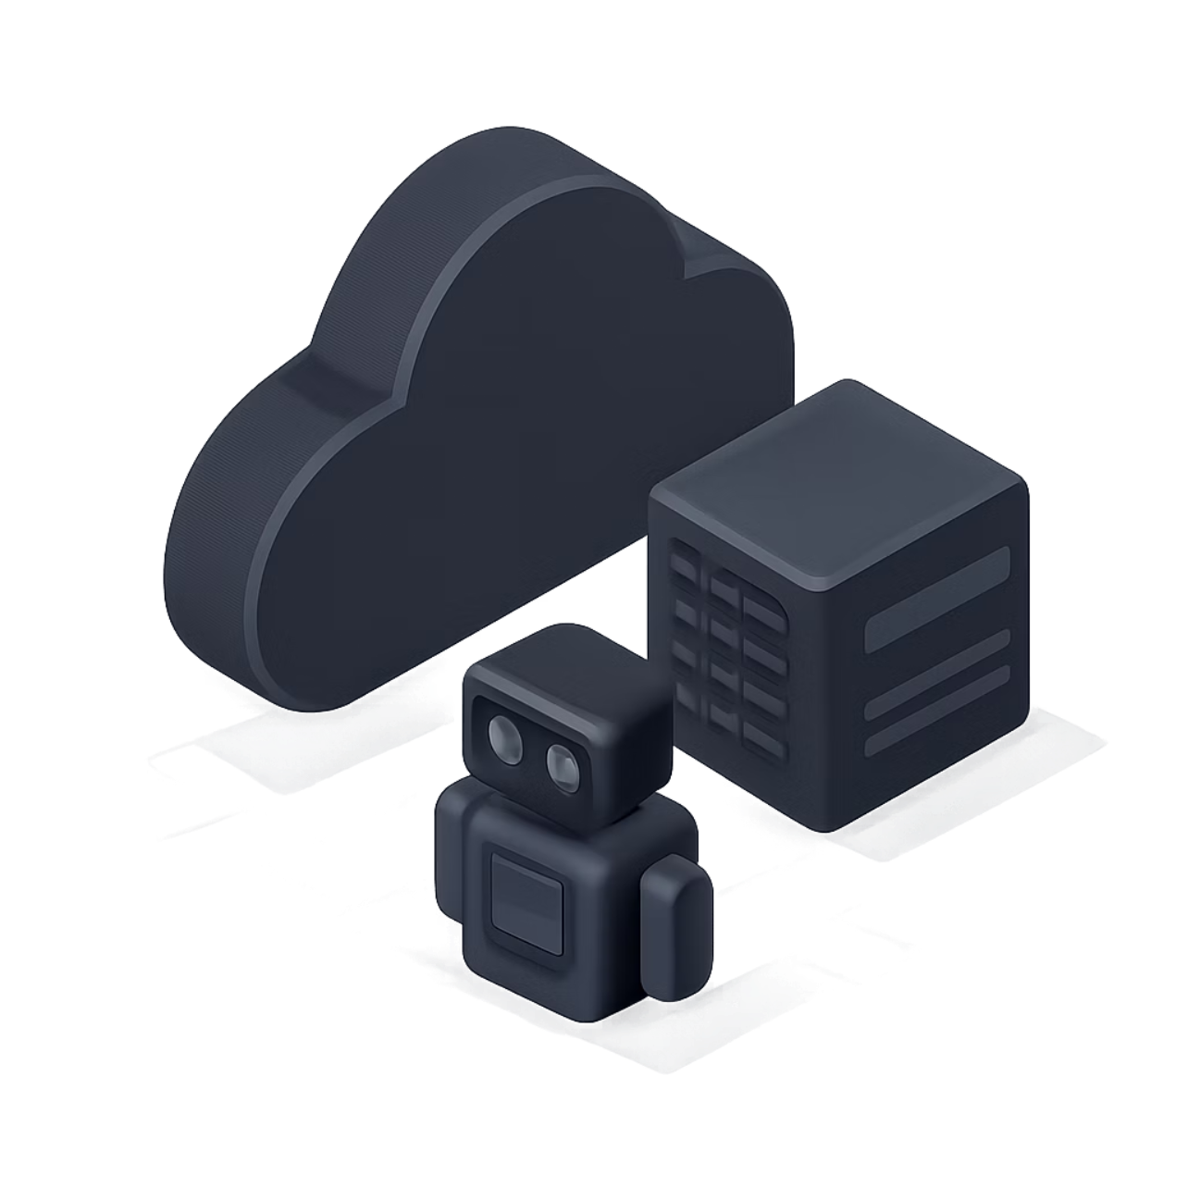
The AI‑Driven Future
AI adds predictive capacity: forecast demand, pre‑warm caches, optimise placement and detect anomalies. Combined with XaaS, infrastructure becomes increasingly self‑healing and autonomous.
Predictive autoscaling and cost optimisation
Policy‑based remediation and self‑healing workflows
Automated compliance and continuous optimisation

Slide 9
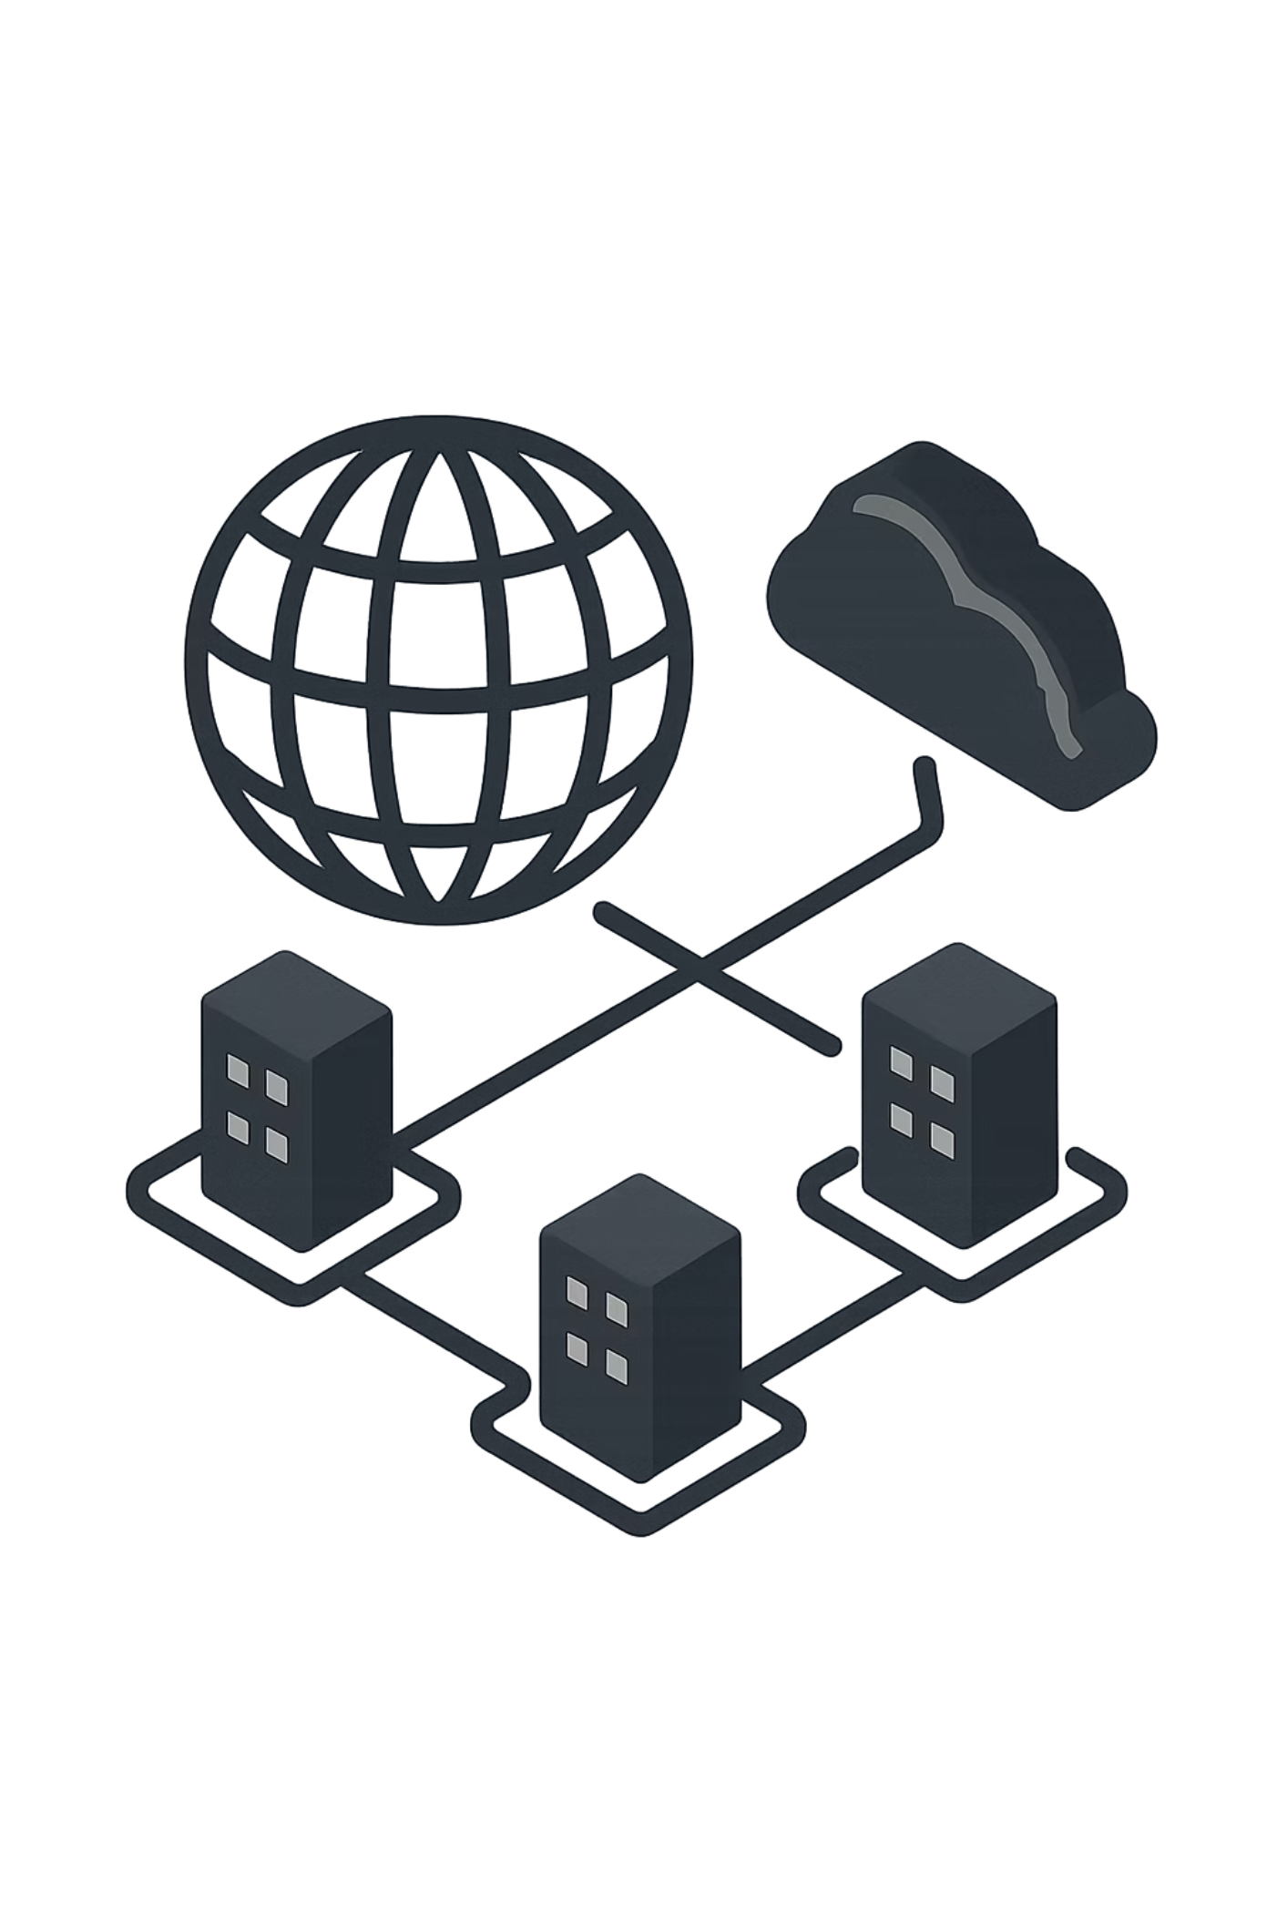

Strategic Impact: Transforming the Business
Adopting XaaS reshapes operating models: it enables global interoperability, rapid experimentation, and a utility‑style interface for services. Organisations can focus investment on business logic, not infrastructure plumbing.
Example stat: large percentage of UK enterprises already use cloud for core services — a clear tilt toward consumption models.

Slide 10
Conclusion
1
2
3
Adopt the Utility Mindset
Automate and Observe
Plan for AI‑Driven Operations
Treat infrastructure as consumable capability — design for composability and API contracts.
Invest in orchestration, telemetry and FinOps to make consumption predictable and accountable.
Use predictive models to reduce waste and enable self‑healing service delivery.
Start by mapping workloads to XaaS patterns today: identify candidates for migration, measure TCO, and pilot a services fabric for repeatable, measurable outcomes.

Slide 11
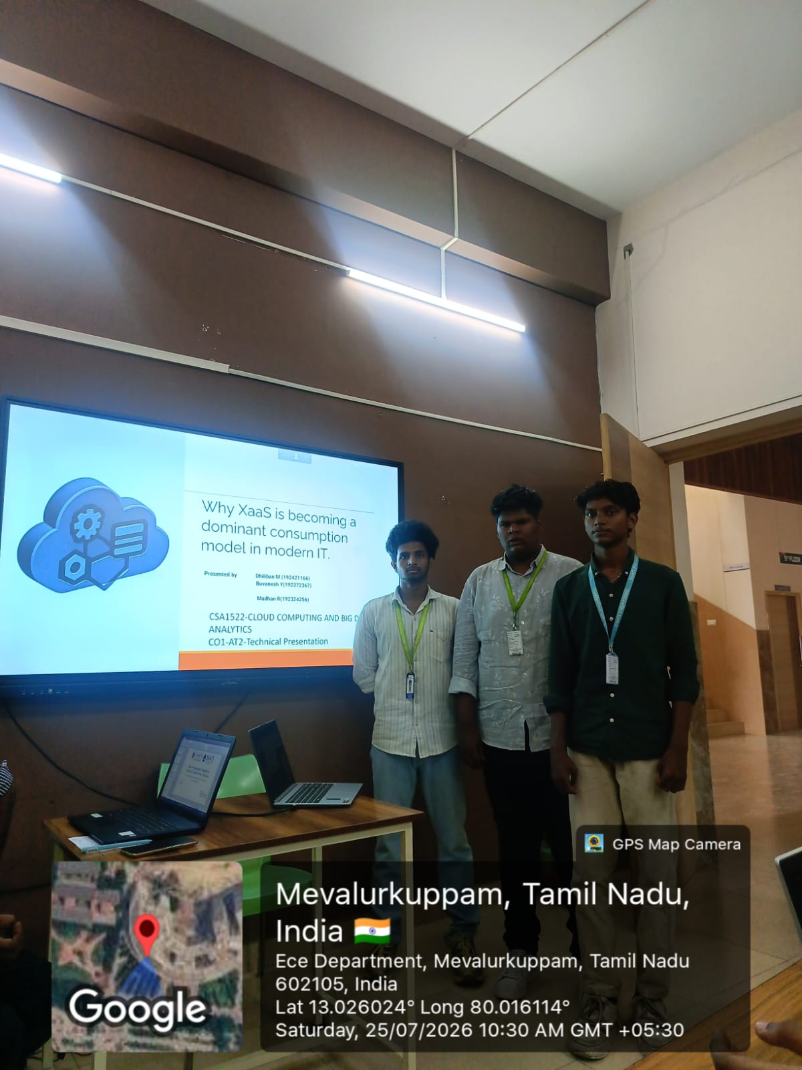
GEO TAG PHOTO

Slide 12
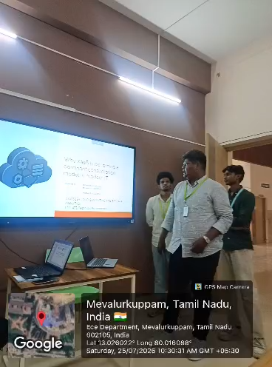
GEO TAG VIDEO

